Slide 1

COVID-19 Data Analysis
By Dimas Saptoaji

Slide 2
Background
Introduction:
COVID-19 was first identified in December 2019 in Wuhan, China
WHO declared the pandemic on March 11th 2020
One of the deadliest pandemics in history of human life:
More than 133 millions case have been confirmed, as of April 8th 2021
More than 2.89 million deaths
About the Virus:
Appears to spread quickly among people.
The virus spreads through droplets of saliva of discharge from the nose when an infected person coughs or sneezes
Can cause a range of symptoms, ranging from mild illness to pneumonia

Slide 3
Stakeholders
Stakeholders | Responsibilities
State Institutions and Policy Makers | Provide clear and relevant information and establish policies to protect the public from a pandemic.
Business Actors and Enterpreneurs | Protect the health and safety of our employees, complying with government guidelines and regulations related to health protocols, and making business innovations to adapt to the pandemic situation.
Healthcare Units and Organizations | Provide treatment for infected people, manage vaccination programmes, initiate contact tracing, and educate the public on preventive measures, isolation, and care.

Slide 4
Problems
Problems in eradication of COVID-19
Public Health: The COVID-19 pandemic causes serious challenges for healthcare systems all over the world, and the amount and quality of a nation's health infrastructure can have a significant effect on the number of cases of COVID-19 infection.
Disinformation and disobedience: The COVID-19 outbreak has led to a lot of false information and even conspiracy theories, which may lead to disobedience to preventive and containment measures and medical treatment.
Economic Impact: Lockdowns and restrictions on activities to control the spread of the virus have affected the global economy. Many workers lost their jobs, businesses have suffered losses and certain sectors have gone into crisis causing some countries to even experience a reduction in their GDP per capita.

Slide 5

Analysis
Using SQL and Tableau

Slide 6
Global Statistics
January 1st 2020 – September 24th 2023
Total Case:
770.793.189
Total Deaths:
6.958.740
Death Percentage:
0,9%
The relatively low percentage of deaths may be due to various factors including advances in medical technology, more expansive vaccination activities, and the better implementation of health protocols and social restrictions.

Slide 7
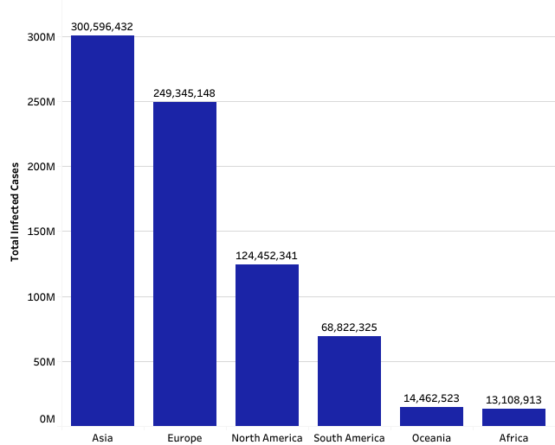
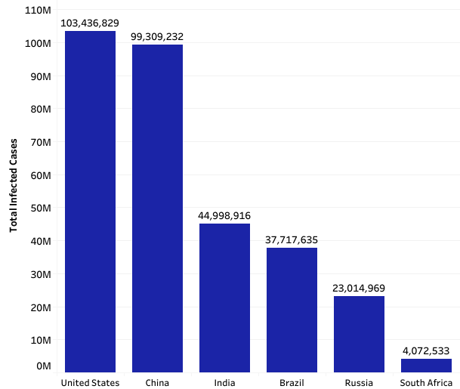
Total Infected Cases
January 1st 2020 – September 24th 2023
COVID-19 cases in the United States are the highest in the world, accounting for 34.4% of all cases in Asia. This is due to the fact that the US government does not maintain as strict social restrictions as other countries. The US government doesn't enforce social distancing and people don't pay as much attention to wearing masks and keeping their distance.

Slide 8
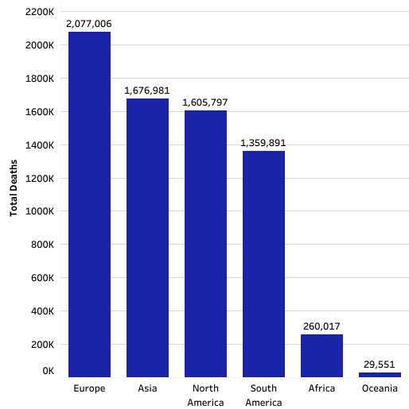
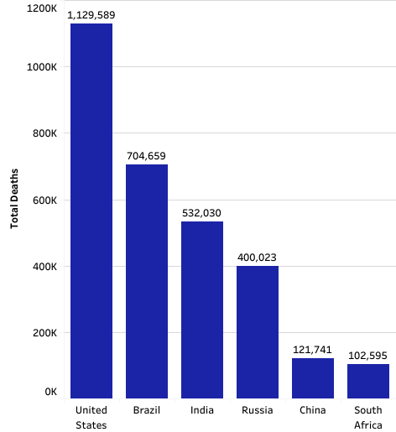
Total Deaths
January 1st 2020 – September 24th 2023
The number of deaths in the European continent is higher than in Asia, even though the most infected cases are found in Asia. This is due to several factors, one of which is that some regions in Asia were quicker to handle COVID-19 cases by implementing social distancing at the beginning of the pandemic. In addition, the experiences of Asian countries in fighting against SARS and MERS epidemics have led to much more swift responses to the pandemic.

Slide 9
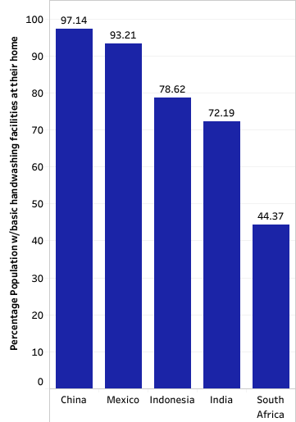
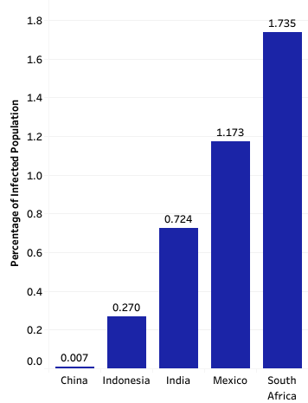
Infected Case vs Availability of Handwashing Facilities
in 2020
Both charts above show that the percentage of handwashing facility ownership is inversely proportional to the percentage of COVID-19 infections. This suggests that the availability of sanitation facilities has a significant impact on the number of COVID-19 cases in a country.

Slide 10
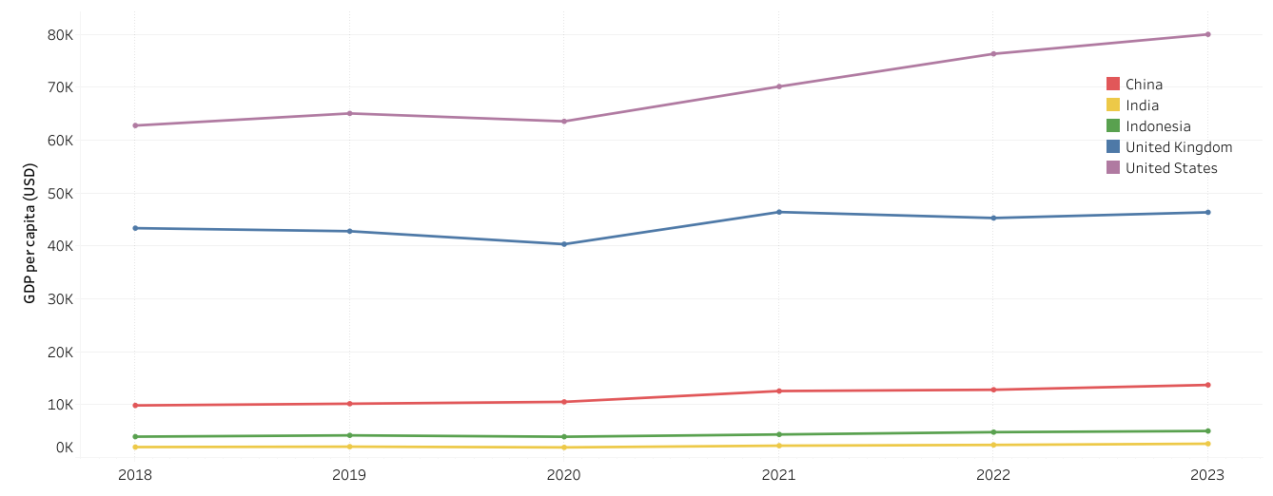
GDP Per Capita
First Year of COVID-19
Of the many countries that suffered an overall decrease in GDP per capita in 2020, China's GDP per capita value increased from 2019 due to the fact that well-known, China was the country where the COVID-19 virus was initially discovered and where the COVID-19 outbreak's first case was reported.

Slide 11
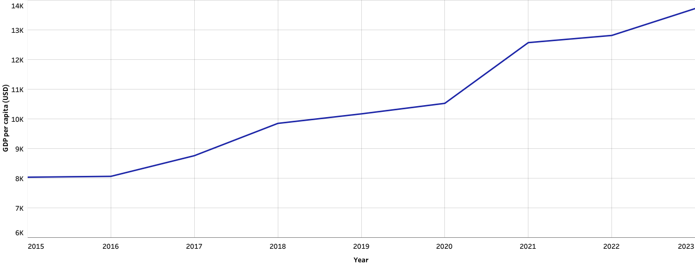
China: GDP Per Capita
There are several factors that cause China's GDP per capita has increased despite the pandemic situation, including:
Pandemic Control: Compared to other countries, the Chinese government's decisive action in controlling the COVID-19 pandemic limiting the spread of the virus and allowing the economy to operate more quickly.
Industrial Recovery: As global market demand recovers, China's exports can grow rapidly, boosting its manufacturing industry and global economy.
The Stimulus Programme: To support economic growth during the pandemic, the Chinese government has also launched an economic stimulus programme, which includes incentives for investment, consumption, and specified sectors.

Slide 12
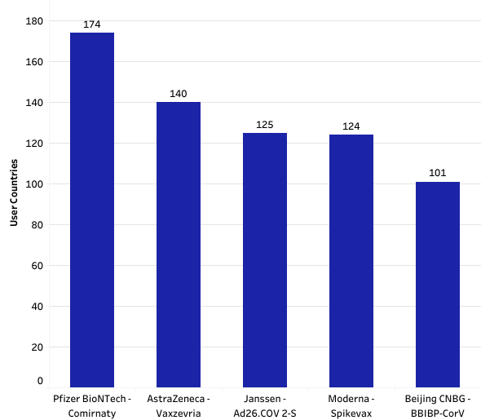
Most Used Vaccines (Top 5)
Based on Manufacturers and Product Name
With 174 countries that have used the Pfizer BioNTech-made vaccine, both in the form of doses 1, 2 and boosters, this vaccine is the most widely used. This is because it has a 95% efficacy rate and is likely to be suitable for everyone with low side effects.

Slide 13
Act

Slide 14
Recommendations
Political Aspects:
Economic Aspects:
Organize alignment of efforts between different political parties to reach a consensus on the pandemic situation.
Provide people with clear, accurate and reliable information on the COVID-19 outbreak.
Educate the public on health protocols, vaccinations, and preventive measures.
Provide subsidies and stimulus to restore people's purchasing power.
Implement digital transformation to face economic challenges related to COVID-19 and improve operational efficiency.
Create flexibility in regulations, such as business licenses and environmental permits, to help businesses adapt to changing conditions.
Invest in education and training to assist people who have lost their jobs due to the pandemic.
Public Health Aspects:
Increase surveillance efforts and contact tracing to break the chain of virus spread.
Give priority to the distribution and administration of vaccines to as many people as possible.
Make sure there is an accessible hygiene facility that contains soap and clean water in all public facilities.

Slide 15
Thank You

